Slide 1
Oracle Clusterware
Installation and Configuration

Slide 2
Objectives
After completing this lesson, you should be able to:
  Describe the installation of Oracle RAC 11gR2
  Perform RAC preinstallation tasks
  Perform cluster setup tasks
  Install Oracle Clusterware
Notes:
Oracle Database 11g: RAC Administration 1 - <number>

Slide 3
Oracle RAC 11gR2 Installation
Oracle RAC 11gR2 incorporates a two-phase installation process:
  Phase one installs Oracle Clusterware.
  Phase two installs the Oracle Database 11gR2 software with RAC.
Notes:
Oracle Database 11g: RAC Administration 1 - <number>
Oracle RAC 11g Installation
The installation of Oracle Database 11gR2 requires that you perform a two-phase process in which you run the Oracle Universal Installer (OUI) twice. The first phase installs Oracle Clusterware. Oracle Clusterware provides high-availability components and can also interact with vendor clusterware, if present, to coordinate cluster membership information.
The second phase installs the Oracle Database 11gR2 software with RAC. The installation also enables you to configure services for your RAC environment. If you have a previous Oracle cluster database version, OUI activates the Database Upgrade Assistant (DBUA) to automatically upgrade your preexisting cluster database. The Oracle Database 11g installation process provides a single-system image, ease of use, and accuracy for RAC installations and patches.
Installation Utilities: New Features
There are new features and changed screens for OUI, Database Configuration Assistant (DBCA), NetCA (Network Configuration Assistant), and DBUA. The enhancements include:
DBCA
Provides the option to switch from a database configured for Oracle Enterprise Manager Database Control to Oracle Enterprise Manager Grid Control

Slide 4
Notes:
Oracle Database 11g: RAC Administration 1 - <number>
Oracle RAC 11gR2 Installation (continued)
Installation Utilities: New Features (continued)
DBUA
On request for a backup during the upgrade, DBUA creates a restore script to restore the database.
Includes an improved pre-upgrade script to provide space estimation, initialization parameters, statistics gathering, and new warnings. DBUA also provides upgrades from Oracle Database releases 9.0, 9.2, 10.1, and 10.2.
Supports in-place patch set upgrades
Starts any services running prior to upgrades
NetCA
NetCA deinstallation removes listener CRS resources that are defined in the same Oracle home and do not have end points in the listener.ora file.
NetCA converts existing noncluster listeners to cluster listeners.

Slide 5

Oracle RAC 11gR2 Installation: Outline
  Complete preinstallation tasks:
    Hardware requirements
    Software requirements
    Environment configuration, kernel
    parameters, and so on
  Perform Oracle Clusterware installation.
  Perform Oracle Database 11gR2 software
  installation.
  Install EM agent on cluster nodes if using Grid Control.
  Perform cluster database creation.
  Complete post installation tasks.
Notes:
Oracle Database 11g: RAC Administration 1 - <number>
Oracle RAC 11g Installation: Outline
To successfully install Oracle RAC 11gR2, it is important that you have an understanding of the tasks that must be completed and the order in which they must occur. Before the installation can begin in earnest, each node that is going to be part of your RAC installation must meet the hardware and software requirements that are covered in this lesson. You must perform step-by-step tasks for hardware and software verification, as well as for the platform-specific preinstallation procedures. You must install the operating system patches required by the cluster database, and you must verify that the kernel parameters are correct for your needs.
Oracle Clusterware must be installed using OUI. Make sure that your cluster hardware is functioning normally before you begin this step. Failure to do so results in an aborted or nonoperative installation.
After Oracle Clusterware has been successfully installed and tested, When clusterware is installed Automatic Storage Management (ASM) instance is also created from oracle 11gR2 and the Oracle Database 11g software, including software options required for a RAC configuration. If you intend to use Enterprise Manager Grid Control to manage your RAC deployments, then you must next install the Enterprise Manager (EM) agent on each cluster node. After the database has been created, there are a few post-installation tasks that must be completed before your RAC database is fully functional. The remainder of this lesson provides the necessary knowledge to complete these tasks successfully.

Slide 6

Windows and UNIX Installation Differences
  Startup and shutdown services
  Environment variables
  DBA account for database administrators
  Account for running OUI
Notes:
Oracle Database 11g: RAC Administration 1 - <number>
Installation Differences Between Windows and UNIX
If you are experienced with installing Oracle components in UNIX environments, note that many manual setup tasks required on UNIX are not required on Windows. The key differences between UNIX and Windows installations are discussed below:
Startup and Shutdown Services
In Windows, OUI creates and sets startup and shutdown services at installation time. In UNIX systems, administrators are responsible for creating these services.
Environment Variables
In Windows, OUI sets environment variables such as PATH, ORACLE_BASE, ORACLE_HOME, and ORACLE_SID in the registry. In UNIX systems, you must manually set these environment variables.
DBA Account for Database Administrators
In Windows, OUI creates the ORA_DBA group. In UNIX systems, you must create the DBA account manually.
Account for Running OUI
In Windows, you log in with Administrator privileges. You do not need a separate account. In UNIX systems, you must create this account manually. On Oracle RAC systems, each member node of the cluster must have user equivalency for the account that installs the database. This means that the administrative privileges user account and password must be the same on all nodes.

Slide 7

Preinstallation Tasks
  Check system requirements.
  Check software requirements.
  Check kernel parameters.
  Create groups and users.
  Perform cluster setup.
Notes:
Oracle Database 11g: RAC Administration 1 - <number>
Preinstallation Tasks
Several tasks must be completed before the Oracle Clusterware and Oracle Database 11gR2 software can be installed. Some of these tasks are common to all Oracle database installations and should be familiar to you. Others are specific to Oracle RAC 11gR2.
Attention to details here simplifies the rest of the installation process. Failure to complete these tasks can certainly affect your installation and possibly force you to restart the process from the beginning.
Note: It is strongly recommended that Network Time Protocol (NTP) be configured on all cluster nodes before you install RAC.

Slide 8
Hardware Requirements
  At least 1 GB of physical memory is needed.
  A minimum of 1 GB of swap space is required.
  The /tmp directory should be at least 400 MB.
  The Oracle Database 11gR2 software requires up to 4 GB of disk space.
# grep MemTotal /proc/meminfo
MemTotal: 1126400 kB
# grep SwapTotal /proc/meminfo
SwapTotal: 1566328 kB
# df -k /tmp
Filesystem 1K-blocks Used Available Use%
/dev/sda6 6198556 3137920 2745756 54%
Notes:
Oracle Database 11g: RAC Administration 1 - <number>
Hardware Requirements
The system must meet the following minimum hardware requirements:
At least 1 gigabyte (GB) of physical memory is needed. To determine the amount of physical memory, enter the following command: grep MemTotal /proc/meminfo
A minimum of 1 GB of swap space or twice the amount of physical memory is needed. On systems with 2 GB or more of memory, the swap space can be between one and two times the amount of physical memory. To determine the size of the configured swap space, enter the following command: grep SwapTotal /proc/meminfo
At least 400 megabytes of disk space must be available in the /tmp directory. To determine the amount of disk space available in the /tmp directory, enter the following command: df -k /tmp. Alternatively, to list disk space in megabytes or gigabytes, enter: df –h.
Up to 4 GB of disk space is required for the Oracle Database 11g software, depending on the installation type. The df command can be used to check for the availability of the required disk space.

Slide 9

Network Requirements
  Each node must have at least two network adapters.
  Each public network adapter must support TCP/IP.
  The interconnect adapter must support User Datagram Protocol (UDP).
  The host name and IP address associated with the public interface must be registered in the domain name service (DNS) or the /etc/hosts file.
Notes:
Oracle Database 11g: RAC Administration 1 - <number>
Network Requirements
Each node must have at least two network adapters: one for the public network interface and the other for the private network interface or interconnect. In addition, the interface names associated with the network adapters for each network must be the same on all nodes.
For the public network, each network adapter must support TCP/IP. For the private network, the interconnect must support UDP (TCP for Windows) using high-speed network adapters and switches that support TCP/IP. Gigabit Ethernet or an equivalent is recommended.
Note: For a more complete list of supported protocols, see MetaLink Note: 278132.1.
Before starting the installation, each node requires an IP address and an associated host name registered in the DNS or the /etc/hosts file for each public network interface. One unused virtual IP address and an associated VIP name registered in the DNS or the /etc/hosts file that you configure for the primary public network interface are needed for each node. The virtual IP address must be in the same subnet as the associated public interface. After installation, you can configure clients to use the VIP name or IP address. If a node fails, its virtual IP address fails over to another node. For the private IP address and optional host name for each private interface, Oracle recommends that you use private network IP addresses for these interfaces, for example, 10.*.*.* or 192.168.*.*. You can use the /etc/hosts file on each node to associate private host names with private IP addresses.

Slide 10


Virtual IP Addresses and RAC
clnode-1
clnode-2
clnode-1vip
clnode-2vip
2
Clients
2
ERP=(DESCRIPTION=
((HOST=clusnode-1))
((HOST=clusnode-2))
(SERVICE_NAME=ERP))
ERP=(DESCRIPTION=
((HOST=clusnode-1vip))
((HOST=clusnode-2vip))
(SERVICE_NAME=ERP))
4
1
5
1
6
6
Timeout
wait
7
5
7
3
3
clnode-2vip
clnode-1
clnode-2
4
clnode-1vip
Notes:
Oracle Database 11g: RAC Administration 1 - <number>
Virtual IP Addresses and RAC
Virtual IP (VIP) addresses are all about availability of applications when an entire node fails.
When a node fails, the VIP address associated with it automatically fails over to some other node in the cluster. When this occurs:
The new node indicates the new Media Access Control (MAC) address for the VIP. For directly connected clients, this usually causes them to see errors on their connections to the old address.
Subsequent packets sent to the VIP address go to the new node, which will send error reset (RST) packets back to the clients. This results in the clients getting errors immediately.
This means that when the client issues SQL to the node that is now down (3), or traverses the address list while connecting (1), rather than waiting on a very long TCP/IP timeout (5), which could be as long as ten minutes, the client receives a TCP reset. In the case of SQL, this results in an ORA-3113 error. In the case of connect, the next address in tnsnames is used (6). The slide shows you the connect case with and without VIP. Without using VIPs, clients connected to a node that died will often wait a 10-minute TCP timeout period before getting an error. As a result, you do not really have a good High Availability solution without using VIPs.
Note: After you are in the SQL stack and blocked on read/write requests, you need to use Fast Application Notification (FAN) to receive an interrupt. FAN is discussed in more detail in the lesson titled “High Availability of Connections.”

Slide 11

RAC Network Software Requirements
  Supported interconnect software protocols are required:
    TCP/IP
    UDP
    Reliable Data Gram
  Token Ring is not supported on AIX platforms.
Notes:
Oracle Database 11g: RAC Administration 1 - <number>
RAC Network Software Requirements
Each node in a cluster requires a supported interconnect software protocol to support Cache Fusion, and TCP/IP to support Oracle Clusterware polling. In addition to UDP, other supported vendor-specific interconnect protocols include Remote Shared Memory, Hyper Messaging protocol, and Reliable Data Gram. Note that Token Ring is not supported for cluster interconnects on AIX. Your interconnect must be certified by Oracle for your platform. You should also have a Web browser to view online documentation.
Oracle Corporation has done extensive testing on the Oracle-provided UDP libraries (and TCP for Windows). On the basis of this testing and extensive experience with production customer deployments, Oracle Support strongly recommends the use of UDP (or TCP on Windows) for RAC environments related to Oracle Database 11g. Best practices for UDP include:
Use at least a gigabit Ethernet for optimal performance.
Crossover cables are not supported (use a high-speed switch).
Increase the UDP buffer sizes to the OS maximum.
Turn on UDP checksumming.
For functionality required from the vendor clusterware, Oracle’s clusterware provides the same functionality. Also, using Oracle Clusterware reduces installation and support complications. However, vendor clusterware may be needed if customers use non-Ethernet interconnect or if you have deployed clusterware-dependent applications.

Slide 12

Package Requirements
  Package versions are checked by the cluvfy utility.
  For example, required packages and versions for Red Hat 4.0 and Oracle Enterprise Linux 4 include:
    glibc-2.3.4-2.25
    glibc-common-2.3.4.2-25
    glibc-devel-2.3.4.2-25
    gcc-3.4.6-3
    gcc-c++-3.4.6-3
    libaio-0.3.105-2
    libaio-devel-0.3.105-2
    libstdc++-3.4.6-3.1
    make-3.80-6
    sysstat-5.0.5-11
Notes:
Oracle Database 11g: RAC Administration 1 - <number>
Package Requirements
Depending on the products that you intend to install, verify that the packages listed in the slide above are installed on the system. Oracle Universal Installer (OUI) performs checks on your system to verify that it meets the Linux package requirements of the cluster database and related services. To ensure that these checks succeed, verify the requirements before you start OUI.
To determine whether the required packages are installed, enter the following commands:
# rpm -q package_name
# rpm –qa |grep package_name_segment
For example, to check the gcc compatibility packages, run the following command:
# rpm –qa |grep compat
compat-libstdc++-33-3.2.3-47.3
compat-gcc-32-3.2.3-47.3
compat-libgcc-296-2.96-132.7.2
compat-gcc-32-c++-3.2.3-47.3
If a package is not installed, install it from your Linux distribution media as the root user by using the rpm –i command. For example, to install the compat-db package, use the following command:
# rpm –i compat-db-4.1.25-9.i386.rpm

Slide 13
Required UNIX Groups and Users
  Create an oracle user, a dba, and an oinstall group on each node:
  Verify the existence of the nobody nonprivileged user:
# groupadd -g 500 oinstall
# groupadd -g 501 dba
# useradd -u 500 -d /home/oracle -g "oinstall" \
–G "dba" -m -s /bin/bash oracle
# grep nobody /etc/passwd
Nobody:x:99:99:Nobody:/:/sbin/nobody
Notes:
Oracle Database 11g: RAC Administration 1 - <number>
Required UNIX Groups and Users
You must create the oinstall group the first time you install the Oracle database software on the system. This group owns the Oracle inventory, which is a catalog of all the Oracle database software installed on the system.
You must create the dba group the first time you install the Oracle database software on the system. It identifies the UNIX users that have database administrative privileges. If you want to specify a group name other than the default dba group, you must choose the custom installation type to install the software, or start OUI as a user that is not a member of this group. In this case, OUI prompts you to specify the name of this group.
You must create the oracle user the first time you install the Oracle database software on the system. This user owns all the software installed during the installation. The usual name chosen for this user is oracle. This user must have the Oracle Inventory group as its primary group. It must also have the OSDBA (dba) group as the secondary group.
You must verify that the unprivileged user named nobody exists on the system. The nobody user must own the external jobs (extjob) executable after the installation.

Slide 14
oracle User Environment
  Set umask to 022.
  Set the DISPLAY environment variable.
  Set the ORACLE_BASE environment variable.
  Set the TMP and TMPDIR variables, if needed.
$ cd
$ vi .bash_profile
umask 022
ORACLE_BASE=/u01/app/oracle; export ORACLE_BASE
TMP=/u01/mytmp; export TMP
TMPDIR=$TMP; export TMPDIR
Notes:
Oracle Database 11g: RAC Administration 1 - <number>
oracle User Environment
You must run OUI as the oracle user. However, before you start OUI, you must configure the environment of the oracle user. To configure the environment, you must:
Set the default file mode creation mask (umask) to 022 in the shell startup file
Set the DISPLAY and ORACLE_BASE environment variables
Secure enough temporary disk space for OUI
If the /tmp directory has less than 400 megabytes of free disk space, identify a file system that is large enough and set the TMP and TMPDIR environment variables to specify a temporary directory on this file system. Use the df -k command to identify a suitable file system with sufficient free space. Make sure that the oracle user and the oinstall group can write to the directory.
# df -k
Filesystem 1K-blocks Used Available Use% Mounted on
/dev/hdb1 3020140 2471980 394744 87% /
/dev/hdb2 3826584 33020 3599180 1% /home
/dev/dha1 386008 200000 186008 0% /dev/shm
/dev/hdb5 11472060 2999244 7890060 28% /u01
# /mkdir /u01/mytmp
# chmod 777 /u01/mytmp

Slide 15
User Shell Limits
  Add the following lines to the /etc/security/limits.conf file:
  Add the following line to the /etc/pam.d/login file:
* soft nproc 2047
* hard nproc 16384
* soft nofile 1024
* hard nofile 65536
session required /lib/security/pam_limits.so
Notes:
Oracle Database 11g: RAC Administration 1 - <number>
User Shell Limits
To improve the performance of the software, you must increase the following shell limits for the oracle user:
nofile: The maximum number of open file descriptors should be 65536.
nproc: The maximum number of processes available to a single user must not be less than 16384.
The hard values, or upper limits, for these parameters can be set in the /etc/security/limits.conf file as shown in the slide above. The entry configures Pluggable Authentication Modules (PAM) to control session security. PAM is a system of libraries that handle the authentication tasks of applications (services) on the system. The principal feature of the PAM approach is that the nature of the authentication is dynamically configurable.

Slide 16
Configuring for Remote Installation
To configure Secure Shell:
  Create the public and private keys on all nodes:
  Concatenate id_dsa.pub from all nodes into the authorized_keys file on the first node:
  Copy the authorized_keys file to the other nodes:
[vx0044]$ /usr/bin/ssh-keygen -t dsa
[vx0045]$ /usr/bin/ssh-keygen -t dsa
[vx0044]$ ssh vx0044 "cat ~/.ssh/id_dsa.pub" >> \ ~/.ssh/authorized_keys
[vx0044]$ ssh vx0045 "cat ~/.ssh/id_dsa.pub" >> \ ~/.ssh/authorized_keys
[vx0044]$ scp ~/.ssh/authorized_keys vx0045:/home/oracle/.ssh/
Notes:
Oracle Database 11g: RAC Administration 1 - <number>
Configuring for Remote Installation
$ rpm -qa|grep -i openssh
openssh-3.9p1-8.RHEL4.20
openssh-askpass-3.9p1-8.RHEL4.20
openssh-clients-3.9p1-8.RHEL4.20
openssh-server-3.9p1-8.RHEL4.20
Assume that your cluster comprises two nodes, vx0044 and vx0045. You can perform the following steps to configure SSH using DSA on that cluster. Note that SSH using SSA is also supported.
1. As the oracle user, create the public and private keys on both nodes:
[vx0044]$ /usr/bin/ssh-keygen -t dsa
[vx0045]$ /usr/bin/ssh-keygen -t dsa
Accept the default location for the key file. When prompted for the pass phrase, just press the Enter key.
2. Concatenate the contents of the id_dsa.pub file from each node into the authorized_keys file on the first node.
[vx0044]$ ssh vx0044 "cat ~/.ssh/id_dsa.pub" >> \ ~/.ssh/authorized_keys
[vx0044]$ ssh vx0045 "cat ~/.ssh/id_dsa.pub" >> \ ~/.ssh/authorized_keys

Slide 17
Notes:
Oracle Database 11g: RAC Administration 1 - <number>
Configuring for Remote Installation (continued)
3. Copy the authorized_keys file to the same location on the second node.
[vx0044]$ scp ~/.ssh/authorized_keys vx0045:/home/oracle/.ssh/
4. Test the configuration.
[vx0044]$ ssh vx0045 hostname
$ ssh vx0045 uptime
vx0045.us.oracle.com

Slide 18

Required Directories for the
Oracle Database Software
You must identify five directories for the Oracle database software:
  Oracle base directory
  Oracle inventory directory
  Oracle Clusterware(and ASM) home directory
  Oracle home directory for the database
Notes:
Oracle Database 11g: RAC Administration 1 - <number>
Required Directories for the Oracle Database Software
The Oracle base (ORACLE_BASE) directory acts as a top-level directory for the Oracle database software installations. On UNIX systems, the Optimal Flexible Architecture (OFA) guidelines recommend that you must use a path similar to the following for the Oracle base directory:
/mount_point/app/oracle_sw_owner
where mount_point is the mount-point directory for the file system that contains the Oracle database software and oracle_sw_owner is the UNIX username of the Oracle database software owner, which is usually oracle.
The Oracle inventory directory (oraInventory) stores the inventory of all software installed on the system. It is required by, and shared by, all the Oracle database software installations on a single system. The first time you install the Oracle database software on a system, OUI prompts you to specify the path to this directory. If you are installing the software on a local file system, it is recommended that you choose the following path: ORACLE_BASE/oraInventory
OUI creates the directory that you specify and sets the correct owner, group, and permissions on it.

Slide 19
Notes:
Oracle Database 11g: RAC Administration 1 - <number>
Required Directories for the Oracle Database Software (continued)
The Oracle Clusterware home directory is the directory where you choose to install the software for Oracle Clusterware. You must install Oracle Clusterware in a separate home directory. Because the clusterware parent directory should be owned by root, it requires a separate base directory from the one used by the database files. When you run OUI, it prompts you to specify the path to this directory, as well as a name that identifies it. It is recommended that you specify a path similar to the following for the Oracle Clusterware home directory:
/u01/crs11gR2
Note that in the example above, /u01 should be owned by the root user and writable by group oinstall.
The Oracle home directory is the directory where you choose to install the software for a particular Oracle product. You must install different Oracle products, or different releases of the same Oracle product, in separate Oracle home directories. When you run OUI, it prompts you to specify the path to this directory, as well as a name that identifies it. The directory that you specify must be a subdirectory of the Oracle base directory. It is recommended that you specify a path similar to the following for the Oracle home directory:
ORACLE_BASE/product/11.1.0/db_1

Slide 20
Linux Operating System Parameters
Parameter | Value | File
semmsl | 250 | /proc/sys/kernel/sem
semmns | 32000 | /proc/sys/kernel/sem
semopm | 100 | /proc/sys/kernel/sem
semmni | 128 | /proc/sys/kernel/sem
shmall | 2097152 | /proc/sys/kernel/shmall
shmmax | ½ physical memory | /proc/sys/kernel/shmmax
shmmni | 4096 | /proc/sys/kernel/shmmni
file-max | 65536 | /proc/sys/fs/file-max
rmem_max | 4194304 | /proc/sys/net/core/rmem_max
rmem_default | 4194304 | /proc/sys/net/core/rmem_default
wmem_max | 262144 | /proc/sys/net/core/wmem_max
wmem_default | 262144 | /proc/sys/net/core/wmem_default
Notes:
Oracle Database 11g: RAC Administration 1 - <number>
Linux Operating System Parameters
Verify that the parameters shown in the table above are set to values greater than or equal to the recommended value shown. Use the sysctl command to view the default values of the various parameters. For example, to view the semaphore parameters, run the following command:
# sysctl -a|grep sem
kernel.sem = 250 32000 32 128
The values shown represent semmsl, semmns, semopm, and semmni in that order. Kernel parameters that can be manually set include:
SEMMNS: The number of semaphores in the system
SEMMNI: The number of semaphore set identifiers that control the number of semaphore sets that can be created at any one time
SEMMSL: Semaphores are grouped into semaphore sets, and SEMMSL controls the array size, or the number of semaphores that are contained per semaphore set. It should be about ten more than the maximum number of the Oracle processes.
SEMOPM: The maximum number of operations per semaphore operation call
SHMMAX: The maximum size of a shared-memory segment. This must be slightly larger than the largest anticipated size of the System Global Area (SGA), if possible.
SHMMNI: The number of shared memory identifiers

Slide 21
Notes:
Oracle Database 11g: RAC Administration 1 - <number>
Linux Operating System Parameters (continued)
RMEM_MAX: The maximum TCP receive window (buffer) size
RMEM_DEFAULT: The default TCP receive window size
WMEM_MAX: The maximum TCP send window size
WMEM_DEFAULT: The default TCP send window size
You can adjust these semaphore parameters manually by writing the contents of the /proc/sys/kernel/sem file:
# echo SEMMSL_value SEMMNS_value SEMOPM_value \
SEMMNI_value > /proc/sys/kernel/sem
To change these parameter values and make them persistent, edit the /etc/sysctl.conf file as follows:
# vi /etc/sysctl.conf
...
kernel.sem = 250 32000 100 128
kernel.shmall = 2097152
kernel.shmmax = 2147483648
kernel.shmmni = 4096
fs.file-max = 65536
rmem_max = 4194304
rmem_default = 4194304
wmem_default = 262144
wmem_max = 262144
net.ipv4.ip_local_port_range = 1024 65000
The kernel parameters shown above are recommended values only. For production database systems, it is recommended that you tune these values to optimize the performance of the system.
Note: Because they are a lot of parameters to check, you can use the Cluster Verification Utility to automatically do the verification.

Slide 22
Cluster Setup Tasks
  View the Certifications by Product section at https://support.oracle.com/.
  Verify your high-speed interconnects.
  Determine the shared storage (disk) option for your system:
    ASM
    OCFS2 or other shared file system solution
    ASM can be used for the OCR and Voting Disk files (From 11gR2)!
  Install the necessary operating system patches.
Notes:
Oracle Database 11g: RAC Administration 1 - <number>
Cluster Setup Tasks
Ensure that you have a certified combination of the operating system and the Oracle database software version by referring to the certification information on Oracle MetaLink in the Availability & Certification section. See the Certifications by Product section at http://metalink.oracle.com.
Verify that your cluster interconnects are functioning properly. If you are using vendor-specific clusterware, follow the vendor’s instructions to ensure that it is functioning properly.
Determine the storage option for your system, and configure the shared disk. Oracle recommends that you use Automatic Storage Management (ASM) and Oracle Managed Files (OMF), or a cluster file system such as Oracle Cluster File System (OCFS2). If you use ASM or a cluster file system, you can also utilize OMF and other Oracle Database 11g storage features.
Oracle Clusterware requires that the OCR files and voting disk files be shared best practise to store ocr and voting disk in ASM diskgroups.

Slide 23
Verifying Cluster Setup with cluvfy
  Install the cvuqdisk rpm required for cluvfy:
  Run the cluvfy utility as oracle as shown below:
# su root
# cd /stage/db/rpm
# export CVUQDISK_GRP=dba
# rpm -iv cvuqdisk-1.0.1-1.rpm
# cd /stage/db
./runcluvfy.sh stage -post hwos -n all -verbose
Notes:
Oracle Database 11g: RAC Administration 1 - <number>
Verifying Cluster Setup with cluvfy
The Cluster Verification Utility (cluvfy) enables you to perform many preinstallation and postinstallation checks at various stages of your RAC database installation. The cluvfy utility is available in Oracle Database 11g Release 1. To check the readiness of your cluster for an Oracle Clusterware installation, run cluvfy as shown below:
$ runcluvfy.sh stage -post hwos -n all -verbose
Performing post-checks for hardware and operating system setup
Checking node reachability...
...
Result: Node reachability check passed from node "vx0044".
Checking user equivalence...
...
Result: User equivalence check passed for user "oracle".
Checking node connectivity...
...
Result: Node connectivity check passed.
Checking shared storage accessibility...
...
Shared storage check passed on nodes "vx0045,vx0044".
...
Post-check for hardware and operating system setup was successful on all the nodes.

Slide 24
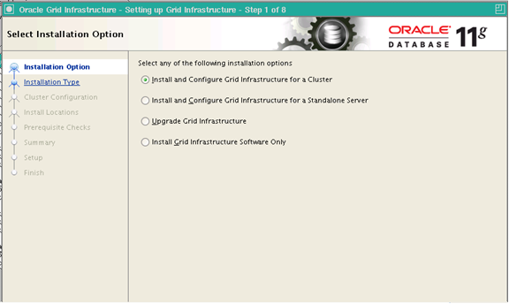
Select Installation Option
Notes:
Oracle Database 11g: RAC Administration 1 - <number>

Slide 25
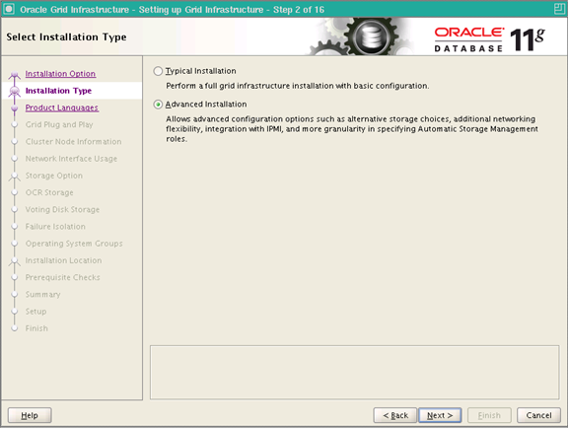
Specify Home Details
Notes:
Oracle Database 11g: RAC Administration 1 - <number>

Slide 26
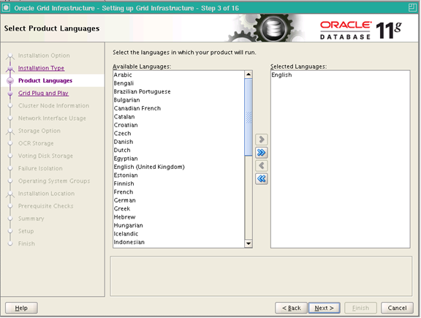
Product-Specific Prerequisite Checks
Notes:
Oracle Database 11g: RAC Administration 1 - <number>
Product-Specific Prerequisite Checks
The installer then checks your environment to ensure that it meets the minimum requirements for an Oracle Clusterware installation. The installer checks for the existence of critical packages and release levels, proper kernel parameter settings, network settings, and so on. If discrepancies are found, they are flagged and you are given an opportunity to correct them. If you are sure that the flagged items will not cause a problem, it is possible to click the item and change the status to self-checked, and continue with the installation. Only do this if you are absolutely sure that no problems actually exist, otherwise correct the condition before proceeding. When all checks complete successfully, click the Next button to proceed.

Slide 27
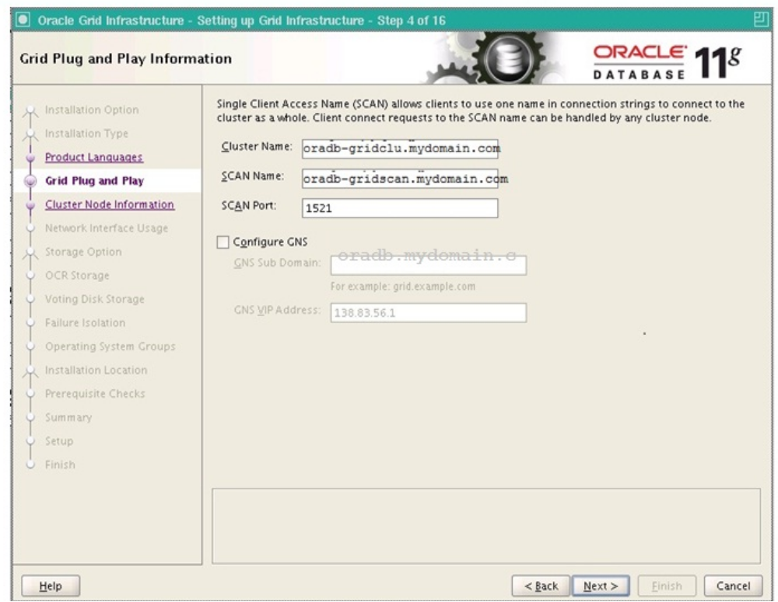
Cluster Configuration
Notes:
Oracle Database 11g: RAC Administration 1 - <number>
SCAN: Single Client Access Name
SCAN is a feature used in Oracle Real Application Clusters
environments that provides a single name for clients to access any Oracle Database running
in a cluster. You can think of SCAN as a cluster alias for databases in the cluster. The benefit
is that the client’s connect information does not need to change if you add or remove nodes or
databases in the cluster.
SCAN was first introduced with Oracle Real Application Clusters (RAC) 11g Release 2 and
provides additional functionality in Oracle RAC 12c. Having a single name to access the
cluster to connect to a database in this cluster allows clients to use EZ Connect and the
simple JDBC thin URL to access any database running in the cluster, independently of the
number of databases or servers running in the cluster and regardless on which server(s) in
the cluster the requested database is actually active.

Slide 28
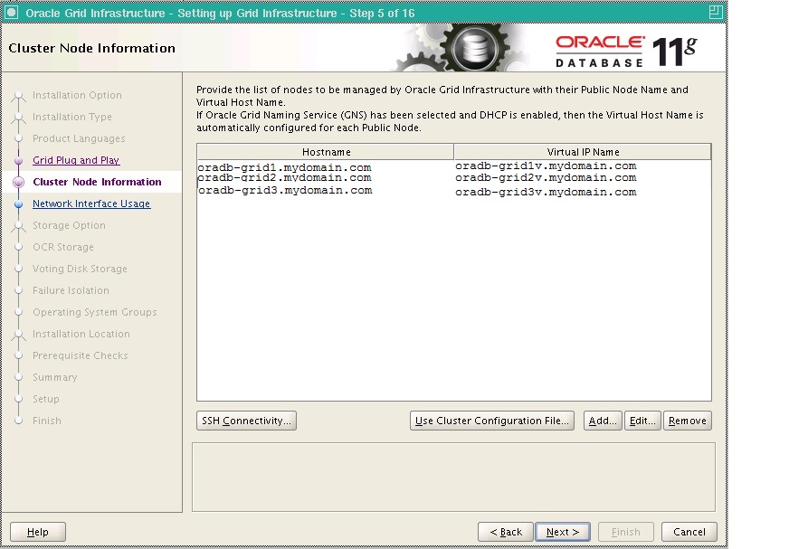
Private Interconnect Enforcement
Notes:
Oracle Database 11g: RAC Administration 1 - <number>

Slide 29
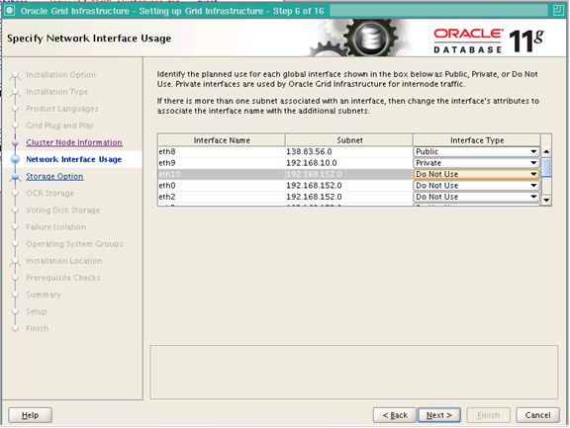
Network Interface
Notes:
Oracle Database 11g: RAC Administration 1 - <number>
Private Interconnect Enforcement
The Specify Network Interface Usage screen enables you to select the network interfaces on your cluster nodes to use for internode communication. Ensure that the network interfaces that you choose for the interconnect have enough bandwidth to support the cluster and RAC-related network traffic. A gigabit Ethernet interface is highly recommended for the private interconnect. To configure the interface for private use, click the interface name, and then click Edit. A pop-up window appears and allows you to indicate the usage for the network interfaces. In the example shown in the slide, there are three interfaces: eth0, eth1, and eth2. The eth0 interface is the hosts’ primary network interface and should be marked Public. The eth1 interface is dedicated for the storage network, which supports this cluster’s shared storage. It should be marked Do Not Use. The eth2 interface is configured for the private interconnect and should be marked Private. When you finish, click the Next button to continue.

Slide 30
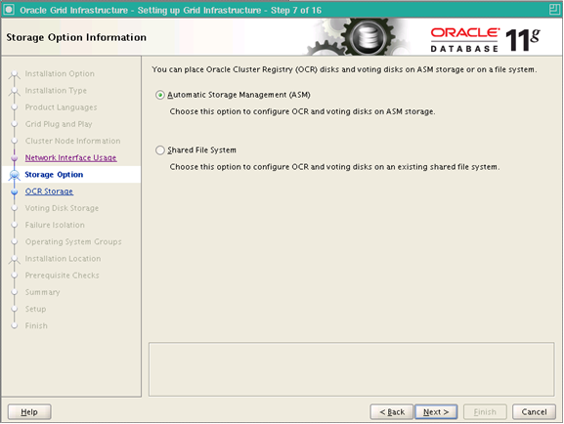
Storage Options
Notes:
Oracle Database 11g: RAC Administration 1 - <number>
Voting Disk File
The primary purpose of the voting disk is to help in situations where the private network communication fails. When the private network fails, the clusters are unable to have all nodes remain available because they cannot synchronize I/O to the shared disk. Therefore, some of the nodes must go offline. The voting disk is used to communicate the node state information used to determine which nodes will go offline.
Because the voting disk must be accessible to all nodes to accurately assess membership, the file must be stored on a shared disk location. The voting disk can reside on a block or raw device or a cluster file system.
In Oracle Database 11g Release 1, voting disk availability is improved by the configuration of multiple voting disks. If the voting disk is not mirrored, then there should be at least three voting disks configured.
Oracle Cluster Registry File
OCR file should be stored in ASM or CFS .You will be prompted for a single OCR file location. If no mirroring scheme is employed, click the Normal Redundancy option button. You will be prompted for two file locations. For highest availability, provide locations that exist on different disks or volumes. Click Next to continue.
From ORACLE11gR2 OCR and Voting can be stored in ASM diskgroups.

Slide 31
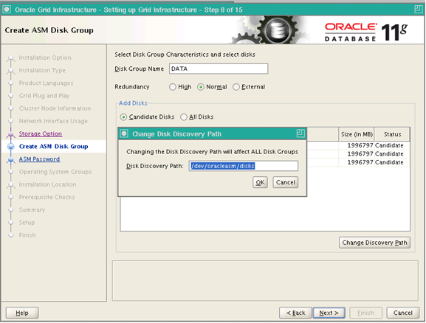
Create ASM Disk Group
Notes:
Oracle Database 11g: RAC Administration 1 - <number>

Slide 32
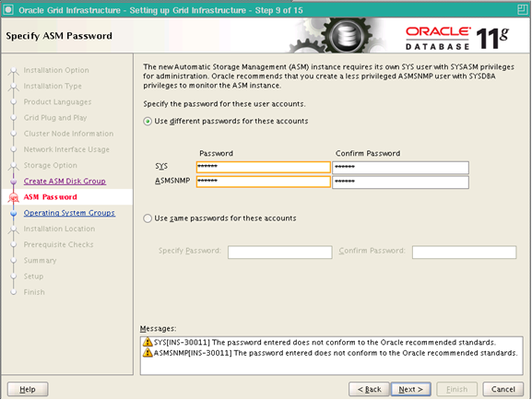
ASM Password
Notes:
Oracle Database 11g: RAC Administration 1 - <number>

Slide 33
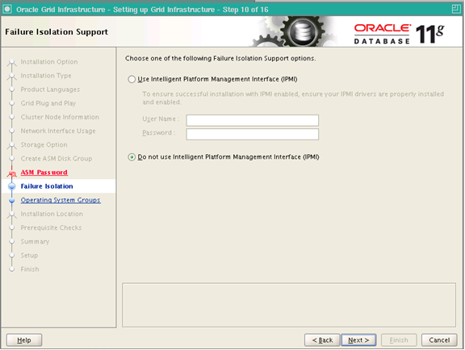
Notes:
Oracle Database 11g: RAC Administration 1 - <number>

Slide 34
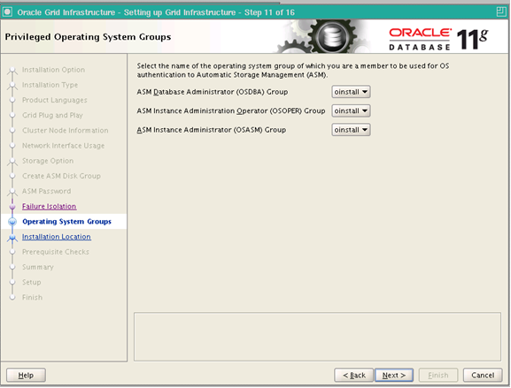
Privileged OS Groups
Notes:
Oracle Database 11g: RAC Administration 1 - <number>

Slide 35
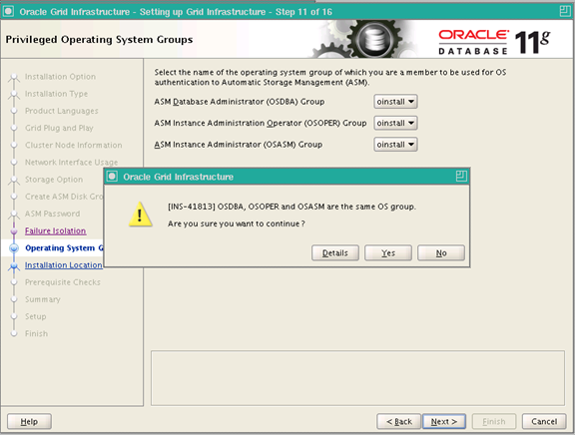
Notes:
Oracle Database 11g: RAC Administration 1 - <number>

Slide 36
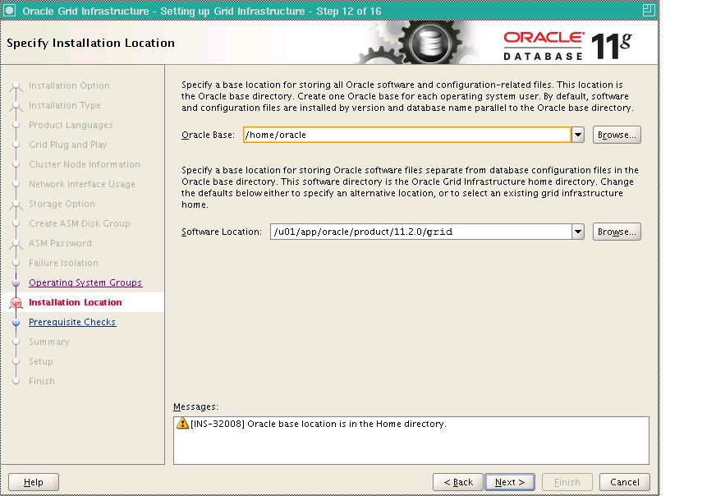
Oracle Home and Base Location
Notes:
Specify Home Details
Next, OUI displays the Specify Home Details screen. The “Specify Home Details” screen contains predetermined information for the source of the installation files and the target destination information. OUI provides an Oracle Clusterware Home name in the Name field located in the Destination section of the screen. You may accept the name or enter a new name at this time. If ORACLE_BASE has been set, an OFA-compliant directory path appears in the Path field located below the Destination section. If not, enter the location in the target destination, and click Next to continue.
If ORACLE_HOME is set in the environment, this appears in the OUI location window. ORACLE_HOME typically refers to the DB home, and there is no corresponding environment variable for the Clusterware installation. You should be aware of this, and not just click through because there is a value. The parent directory of the Clusterware Home should be owned by root and writable by the install group, oinstall.
Oracle Database 11g: RAC Administration 1 - <number>

Slide 37
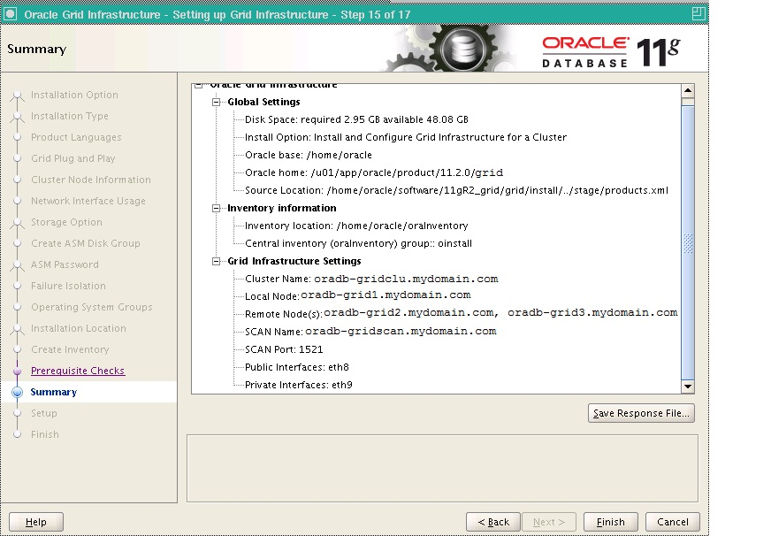
Notes:
Oracle Database 11g: RAC Administration 1 - <number>

Slide 38
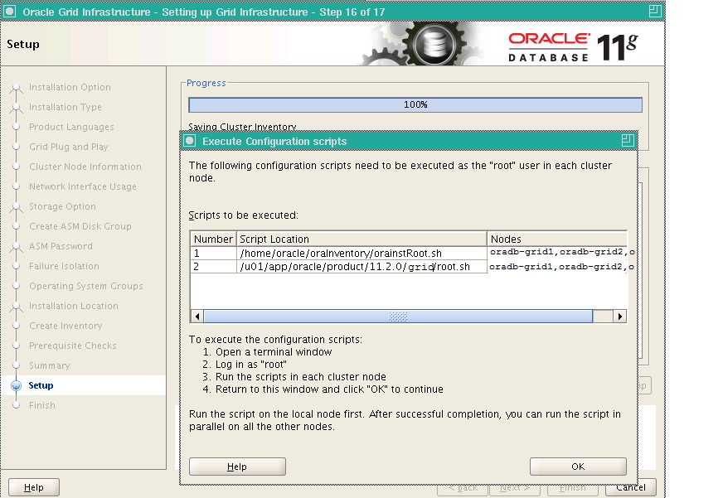
Scripts to be executed on all Nodes
Notes:
The first Script that we run is 'orainstRoot.sh' which is located in $ORACLE_BASE/oraInventory(/u01/app/oracle/oraInventory) path.We execute 'orainstRoot.sh' script for the following purposes:
1)It creates the inventory pointer file (/etc/oraInst.loc),This file shows the inventory location and group it is linked to.
2)It Changes groupname of the oraInventory directory to oinstall group.
'root.sh' script:
The Second script that we run is 'root.sh' script which is located in $ORACLE_HOME (/u01/app/oracle/product/11.2.0/db_1) path.We execute 'root.sh' for the following purposes:
1)It will Creates a /etc/oratab file.This is the file which we use to make automatic Database shutdown and startup.
It is very important file.
2)It Sets the Oracle base and home environments.
3)It Sets an appropriate permission to the OCR base directory
4)It Creates the OCR backup and Network Socket directories.
5)It Modifies the ownership to 'root' user on the Oracle base and Cluster home filesystem.
6)It Configures the OCR and voting disks (only on the first node) etc..
Oracle Database 11g: RAC Administration 1 - <number>

Slide 39
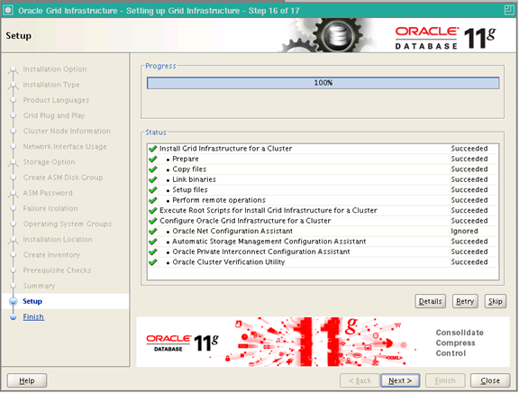
Installation Sucessfull
Notes:
Oracle Database 11g: RAC Administration 1 - <number>

Slide 40
Summary
In this lesson, you should have learned how to:
  Describe the installation of Oracle RAC 11gR2
  Perform RAC preinstallation tasks
  Perform cluster setup tasks
  Install Oracle Clusterware
Notes:
Oracle Database 11g: RAC Administration 1 - <number>

Slide 41
Practice 1: Overview
This practice covers the following topics:
  Performing initial cluster configuration
  Installing Oracle Clusterware
Notes:
Oracle Database 11g: RAC Administration 1 - <number>

